Slide 1
Procedural Generation
Stephen Leitnick
Software Engineer
Not Just for Terrain

Slide 2
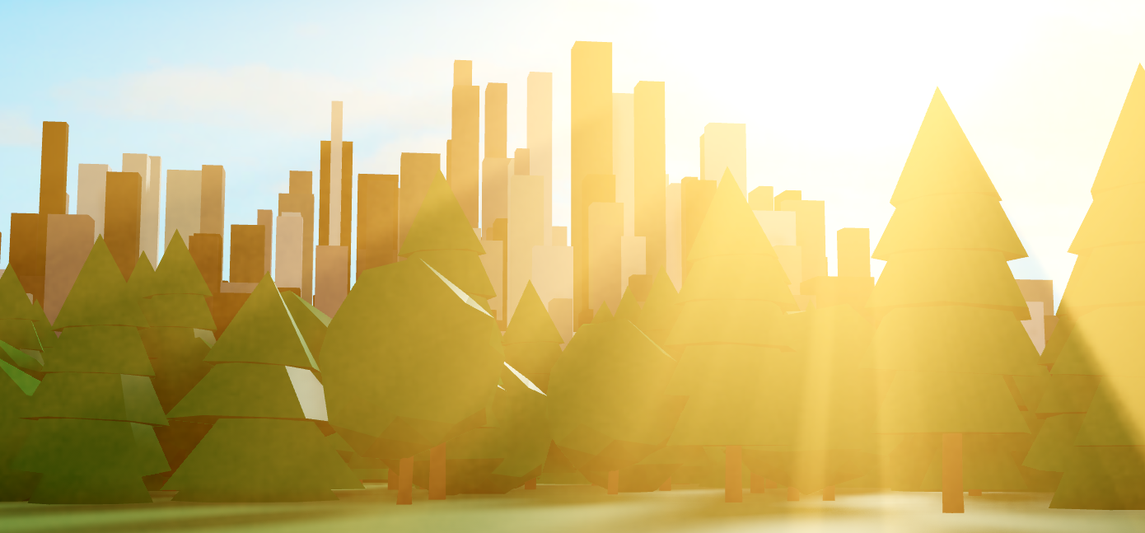

Slide 3


ABOUT ME
Stephen Leitnick
Software Engineer
Crazyman32

Slide 4
AGENDA
What is Procedural Generation?
Generating Heightmaps
Using Perlin Noise
Perlin Noise defined
Generating Heightmaps using fBm
Using Heightmaps to Build Worlds
Thinking Outside the Box
Studio Examples

Slide 5
WHAT IS PROCEDURAL GENERATION?

Slide 6
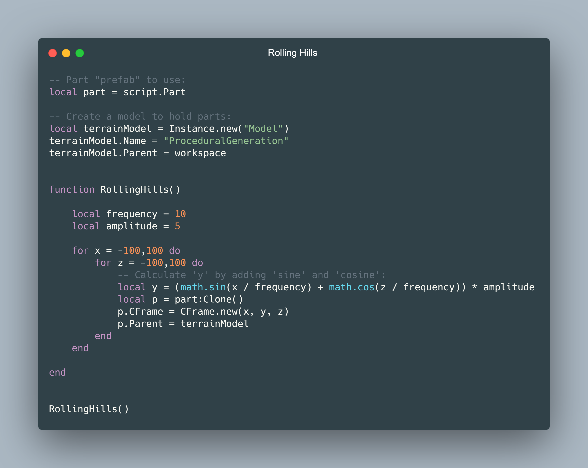
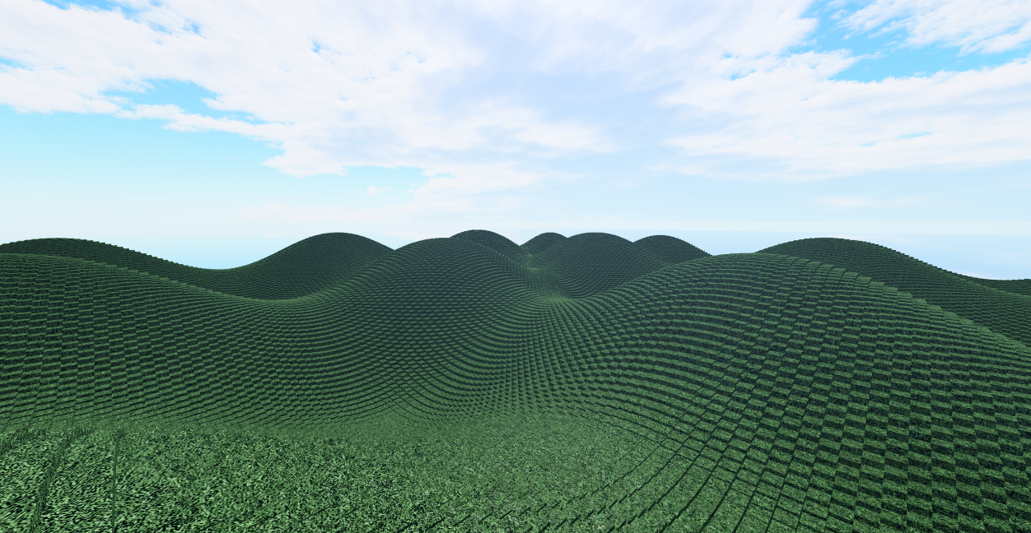
WHAT IS PROCEDURAL GENERATION?
Defined: Using algorithms to create data using pure functions
As opposed to creating the data manually
Example: Rolling Hills
In Video Games
Large, realistic worlds
Infinite possibilities
Easy to recreate exact replicas

Slide 7
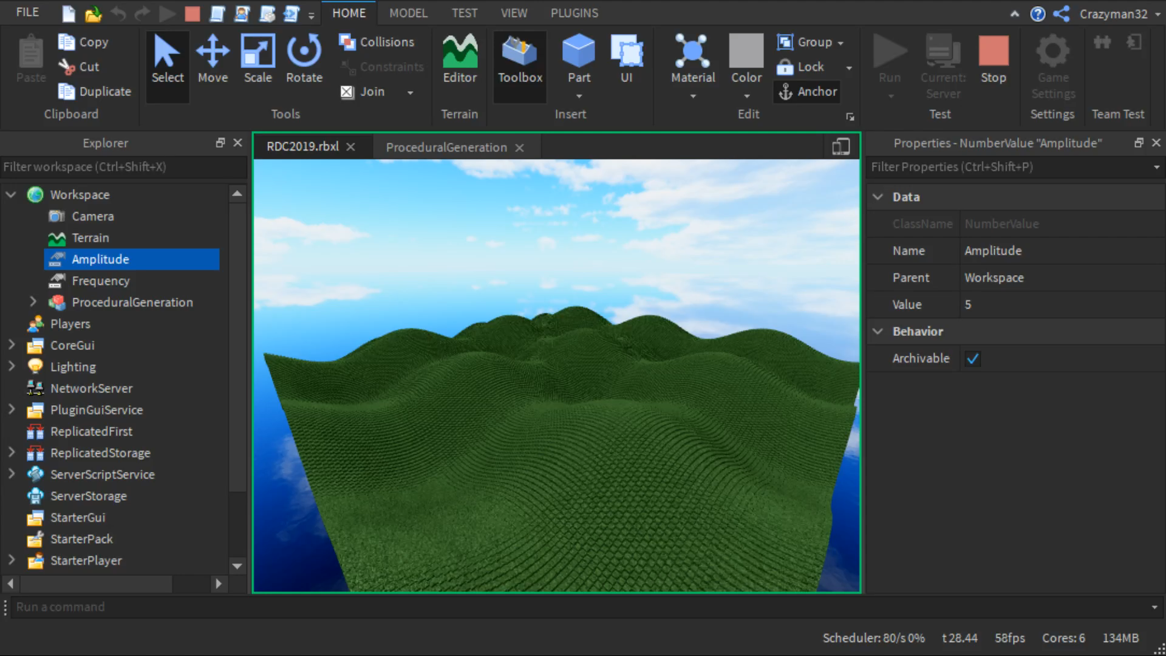

Slide 8
WHAT IS PROCEDURAL GENERATION?
Defined: Using algorithms to create data using pure functions
As opposed to creating the data manually
Example: Rolling Hills
In Video Games
Large, realistic worlds
Infinite possibilities
Easy to recreate exact replicas

Slide 9
GENERATING HEIGHTMAPS

Slide 10
GENERATING HEIGHTMAPS
Understanding math.noise
Takes 1 to 3 arguments (X, Y, Z)
Returns a number between (-0.5, 0.5)
Small deviation possible. Clamp value: math.clamp(n, -0.5, 0.5)
Pure function
Can be “seeded” by offsetting the inputted X, Y, and Z arguments
local n = math.noise(x + seed, y + seed)

Slide 11
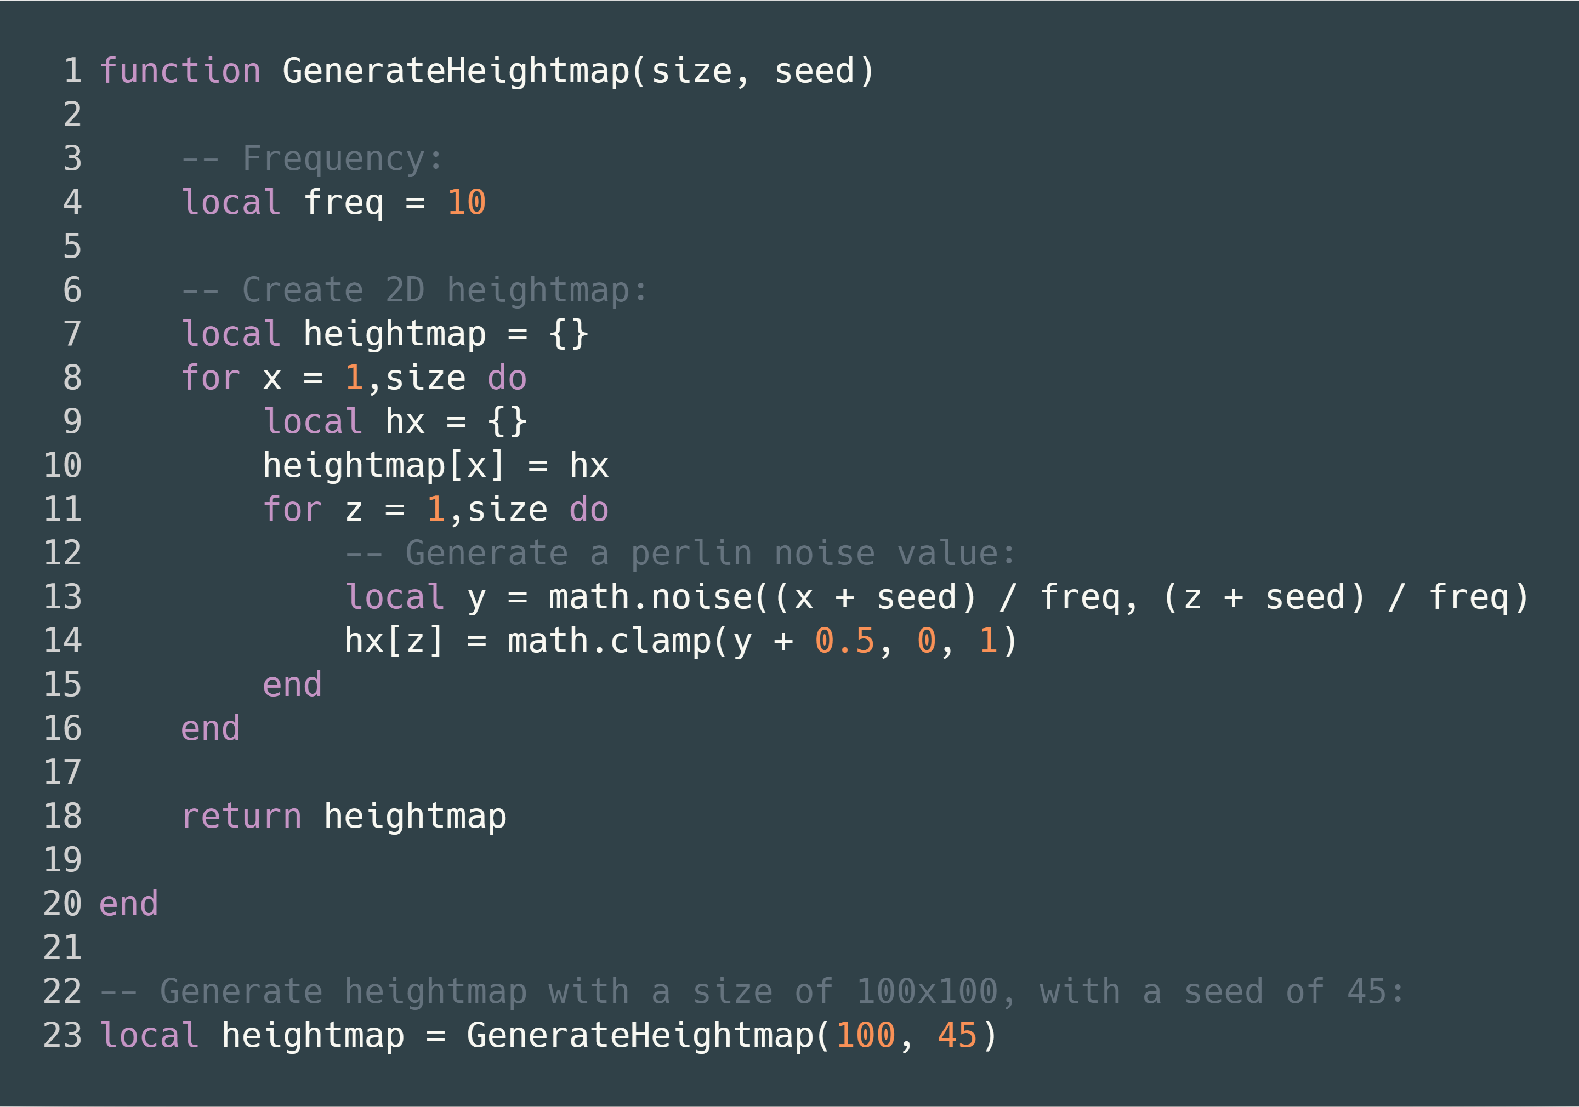
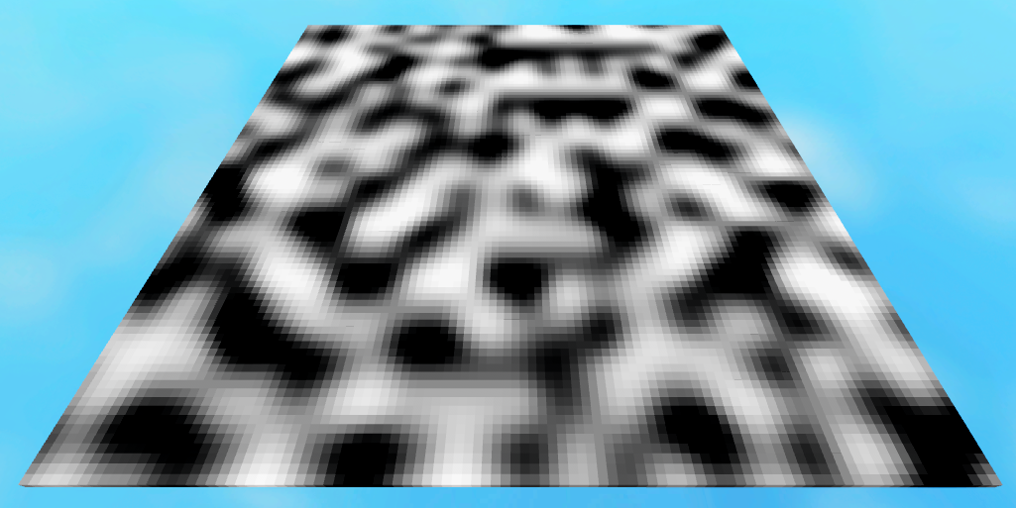
GENERATING HEIGHTMAPS
Creating a heightmap using noise

Slide 12
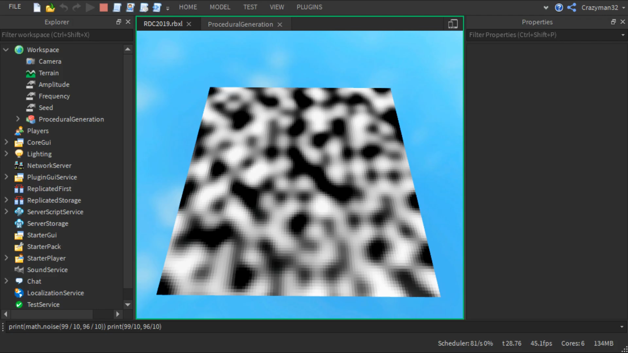

Slide 13
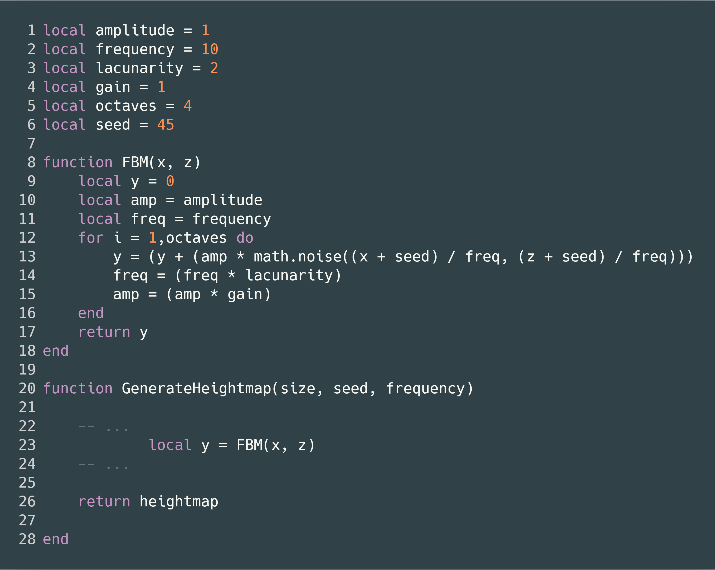
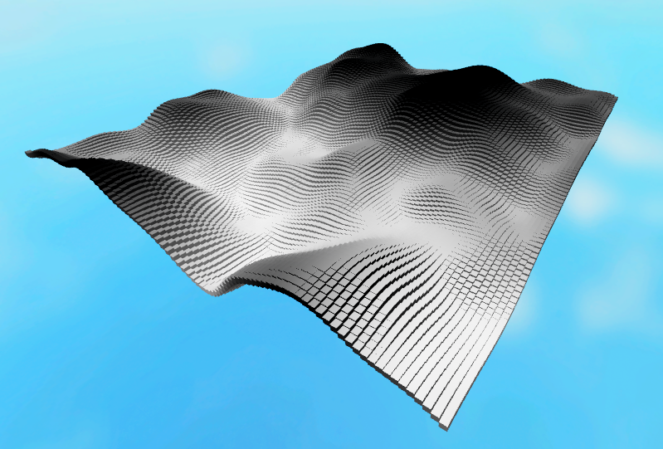
GENERATING HEIGHTMAPS
Creating a heightmap using noise
Using Fractal Brownian Motion (fBm)
Allows us to fine-tune the generator
Still uses Perlin Noise under the hood
Keywords:
Amplitude – How “tall” the heightmap can be
Frequency – Resolution of heightmap
Octaves – Number of noise iterations
Lacunarity – Frequency multiplier per iteration
Gain – Amplitude multiplier per iteration (AKA “Persistence”)

Slide 14
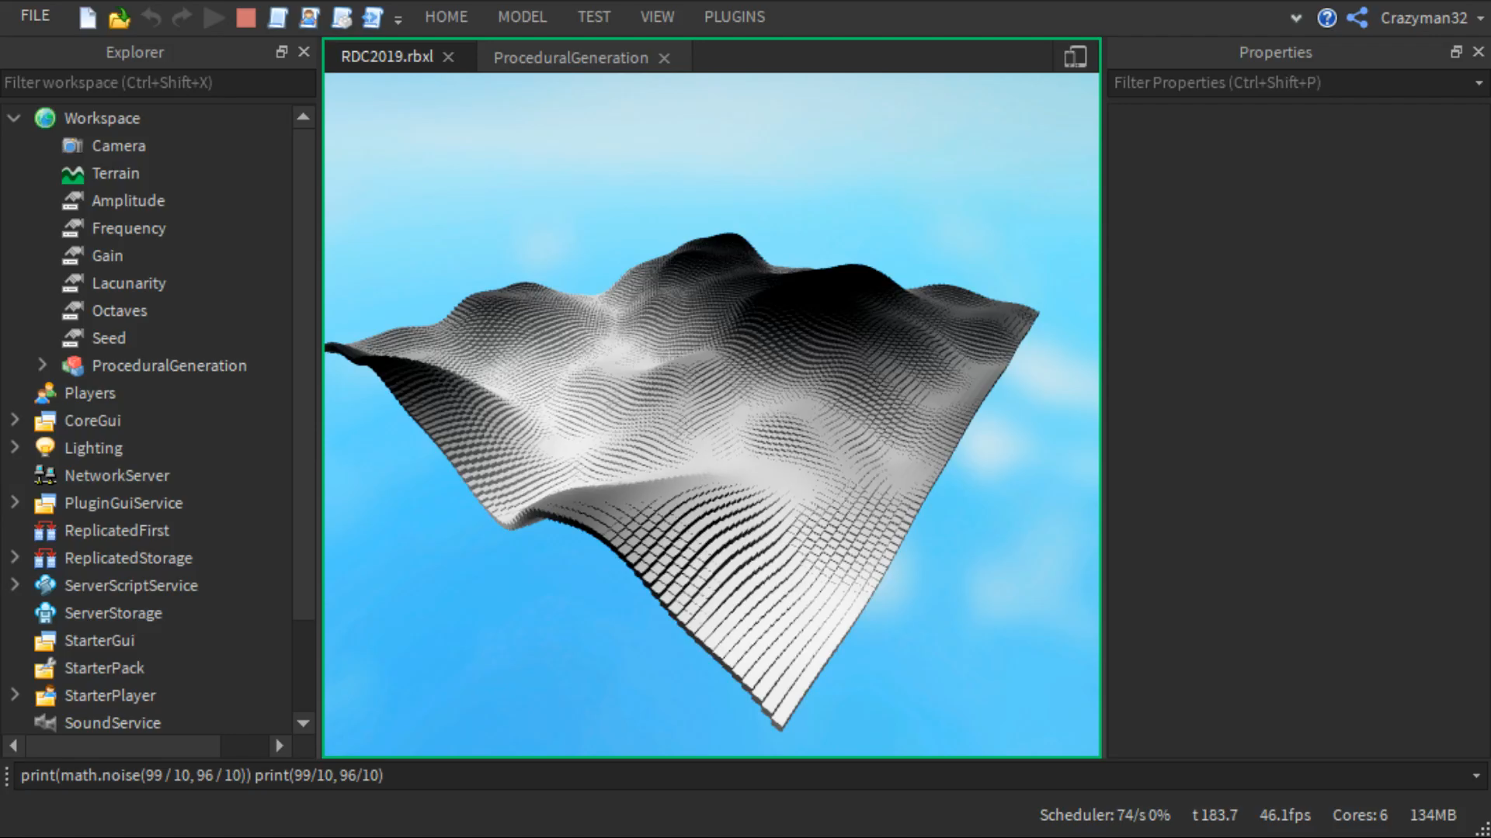

Slide 15
USING HEIGHTMAPS TO BUILD WORLDS

Slide 16
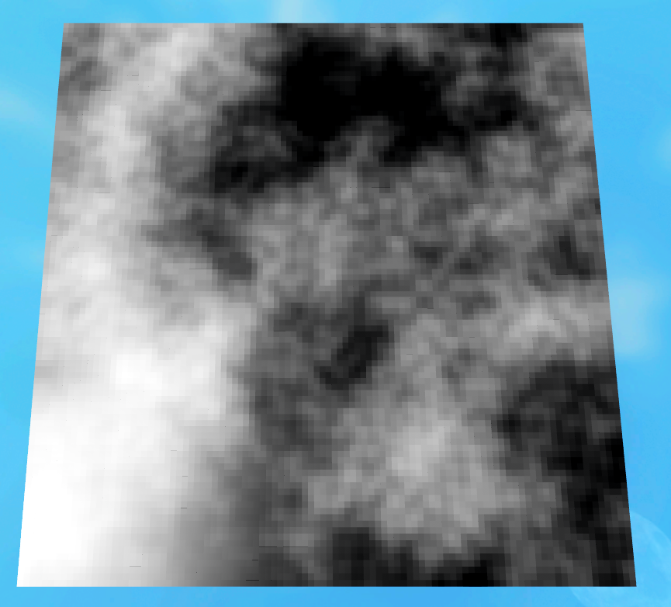
USING HEIGHTMAPS TO BUILD WORLDS
Thinking Outside the Box
Not just “height”
E.g. Darker colors = higher tree density
Examples
Forest
City

Slide 17
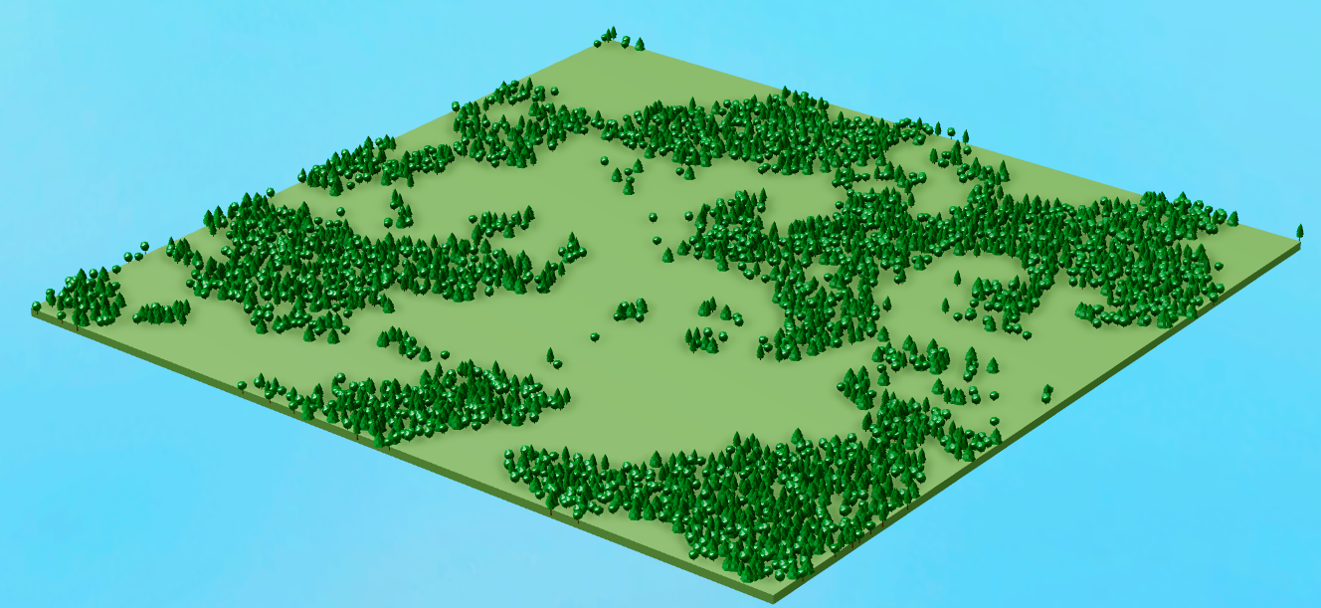
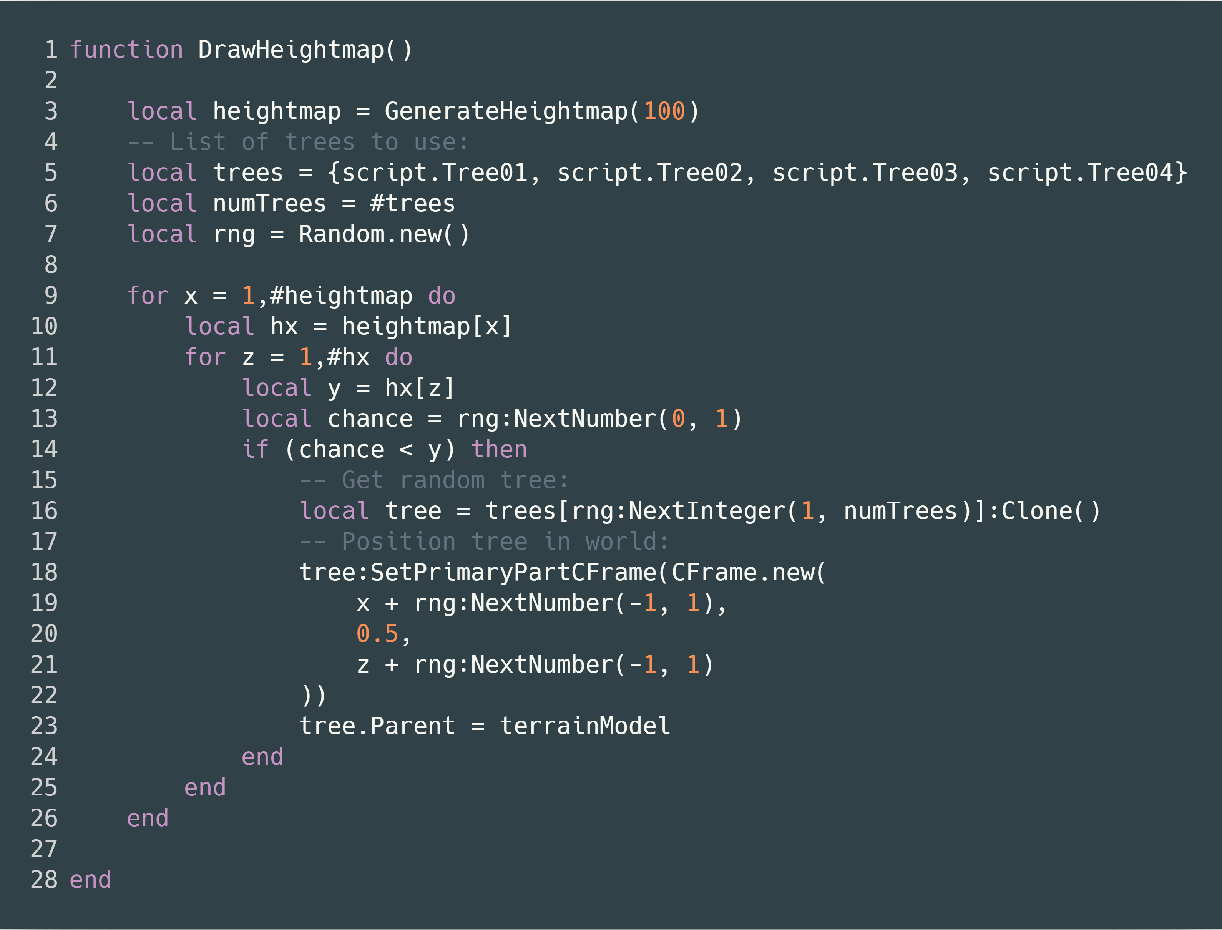

Slide 18
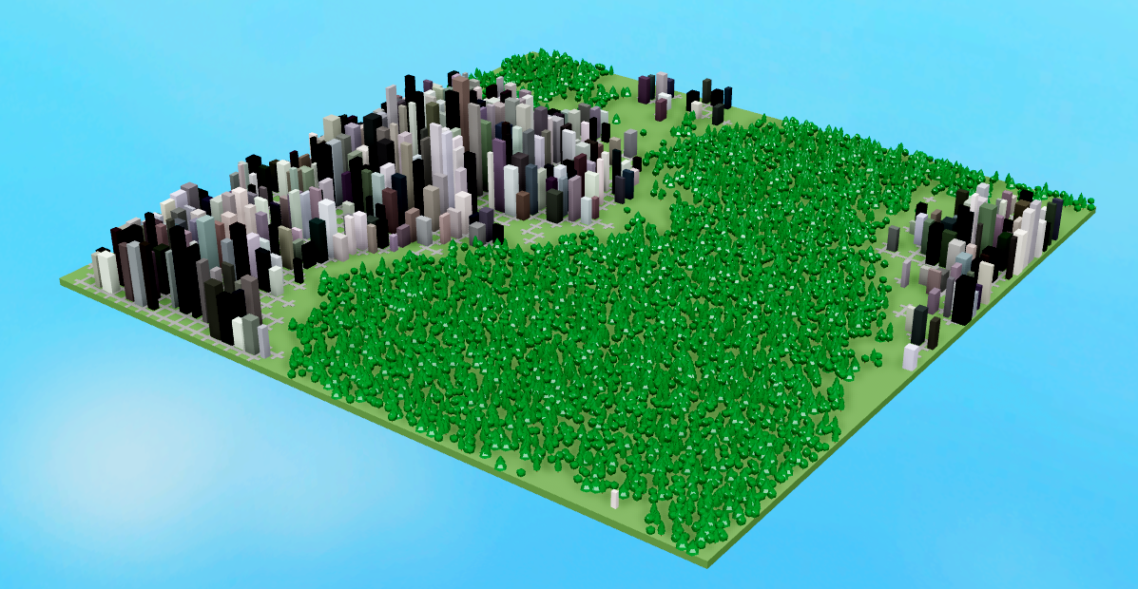

Slide 19
CONCLUSION
Procedural generation is not just for Roblox Terrain
Think outside the box
Flight paths for birds
Paths for animals
Rivers
Weather
The internet is full of resources on procedural generation
Take small steps
Practice generating heightmaps
Use heightmaps to generate parts or trees

Slide 20
Resources
https://github.com/Sleitnick/RDC2019-Procedural-Generation
https://thebookofshaders.com/13/

Slide 21
Thank you for your time.

